Slide 1
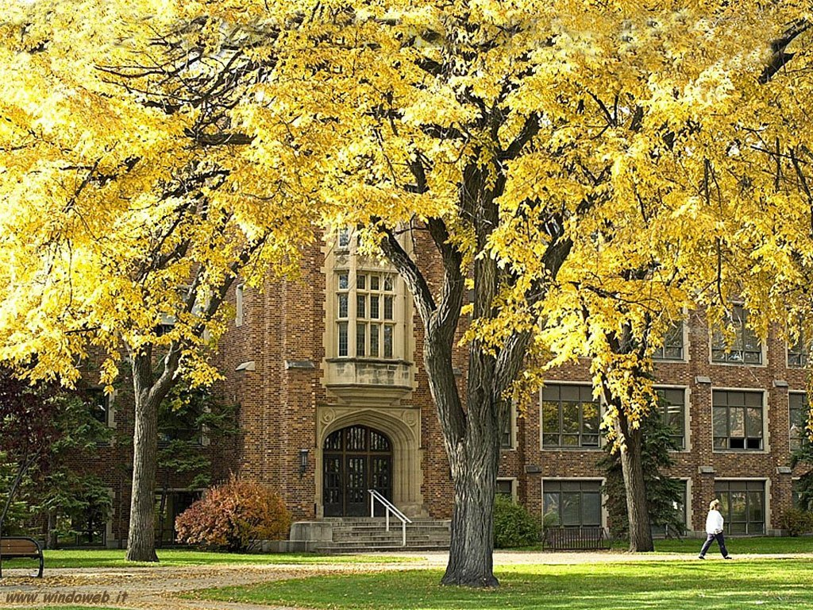
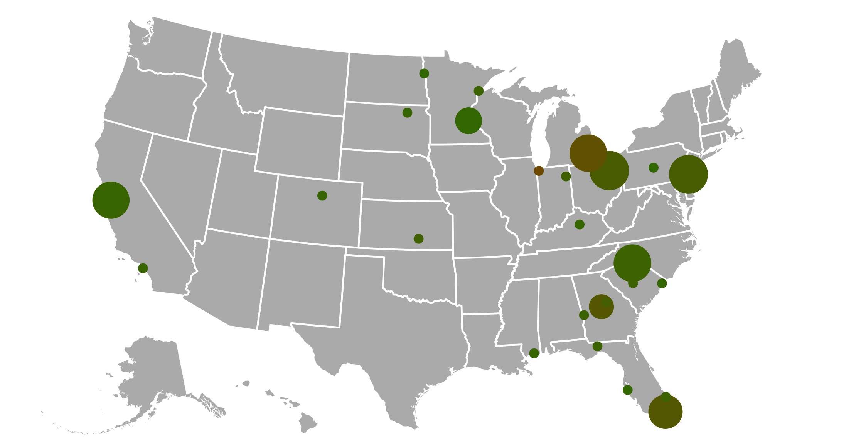
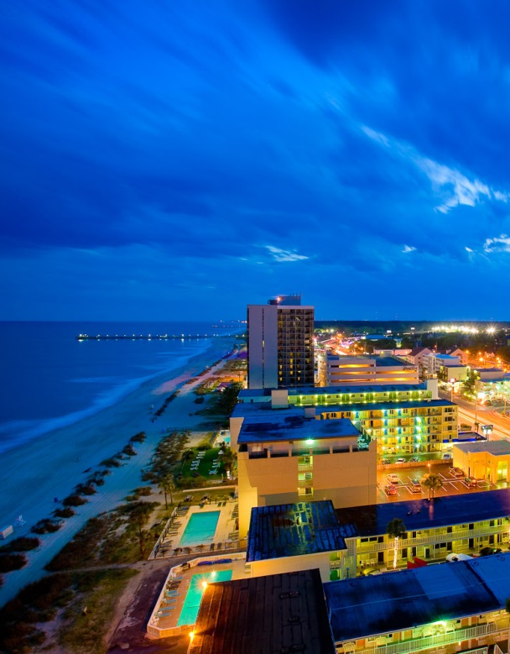
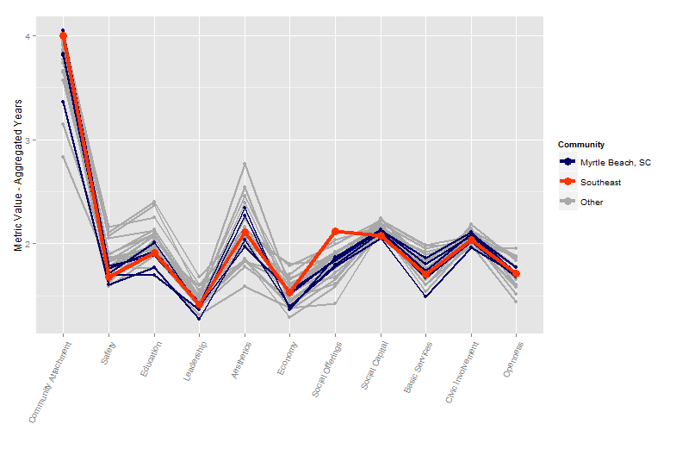
Putting Down Roots: A Graphical Exploration of Community Attachment
Andee Kaplan, Eric Hare
Department of Statistics, Iowa State University
Data
West
Great Plains – Effect of Quality Education
Rust Belt – The Economic Collapse
The data come from the Knight Foundation’s ‘Soul of the Community’ project. The Knight Foundation in cooperation with Gallup collected data from 43,000 people over three years in 26 communities across the United States. The 26 communities do not constitute a random sample of communities across the United States; participating communities were those where the Knight Foundation was already active. Along with survey answers, the data contains derived metrics that were used to gain insight to what makes a community thrive.
The Great Plains states include four of the top six communities in terms of the Education metric. Grand Forks, ND in particular had an average response of 2.40 aggregated over all three years, likely due in part to the presence of the University of North Dakota in the community. Overall, the Great Plains has a correlation between Education and Community Attachment of 0.49, compared to 0.46 for the average of all cities. This might help explain why the Great Plains region has the largest overall Community Attachment among the five regions.
Much of the country was hit hard by the economic collapse, but the Rust Belt notably so. In 2008 and 2009, the Rust Belt region accounted for four of the bottom ten communities in terms of the Economy metric. Nonetheless, the economic center of the rust belt, Detroit, MI, displayed some resilience. Detroit exhibited virtually no change from 2008 to 2009 in the economy metric, going from an average response of 1.26 to 1.25, for a change of 0.01. No other community in the dataset experienced a change of less than 0.06 between these years. The average change was 0.19.
Metrics
Community Attachment | I am proud to say I live in [Community]. [Community] is the perfect place for people like me. Taking everything into account, how satisfied are you with [Community] as a place to live? How likely are you to recommend [Community] to a friend or associate as a place to live? And thinking about five years from now, how do you think [Community] will be as a place to live compared to today?
Safety | How would you rate how safe you feel walking alone at night within a mile of your home? How would you rate the level of crime in your community?
Education | The overall quality of public schools in your community The overall quality of the colleges and universities
Leadership | The leadership of the elected officials in your city The leaders in my community represent my interests
Aesthetics | The availability of outdoor parks, playgrounds, and trails The beauty or physical setting
Economy | The availability of job opportunities How would you rate economic conditions in [Community] today? Right now, do you think that economic conditions in [Community] as a whole are getting better or getting worse? How likely are you to agree that your job provides you with the income needed to support your family? Now is a good time to find a job in my area How satisfied are you with your job, that is, the work you do?
Social Offerings | Having a vibrant nightlife with restaurants, clubs, bars, etc. Being a good place to meet people and make friends How much people in [Community] care about each other
Social Capital | How many formal or informal groups or clubs do you belong to, in your area, that meet at least monthly? How many of your close friends live in your community? How much of your family lives in this area? How often do you talk to or visit with your immediate neighbors?
Basic Services | The highway and freeway system The availability of affordable housing The availability and accessibility of quality healthcare
Civic Involvement | Performed local volunteer work for any organization or group Attended a local public meeting in which local issues were discussed Voted in the local election Worked with other residents to make change in the local community
Openness | Young, talented college graduates looking to enter the job market Immigrants from other countries Families with young children Gay and lesbian people Senior citizens
Southeast – Social Offerings in Myrtle Beach
This fifth most attached community ranks in the lowest half of all communities except in Social Offerings. Myrtle Beach ranks third worst in terms of Social Capital and sixth worst in terms of Safety, as well as Education.
The importance of Social Offerings, for which Myrtle Beach ranks first, explains the discrepancy. Not only is Social Offerings the most highly correlated variable with Community Attachment for Myrtle Beach, but it is the single most highly correlated among all communities. Social Offerings is the most highly correlated variable with Community Attachment for a full 23 of the 26 communities.
Philosophy
Deep South
Our goal in this analysis is to facilitate the understanding of why people feel attachment to their communities. By utilizing an interactive and data driven web-based approach, we place the user in the driver seat of their own experience. The philosophy behind our work has been from the point of view of a community planner, either from one of the communities in the study or from a community in the same region or a similar urbanicity. By exploring the factors that lead to community attachment in a similar community to their own, a user can apply the conclusions to their own situation. See http://glimmer.rstudio.com/andeek/DataExpo2013/ for implementation.
Tools
Interactive Application: Shiny, D3, JQuery, Glimmer Server | Data Manipulation: R, plyr, reshape2, rjson
Universities in the Great Plains Communities:
Aberdeen, SD | Northern State University
Duluth, MN | University of Minnesota Duluth
Grand Forks, ND | The University of North Dakota
St. Paul, MN | Saint Catherine University Concordia University Hamline University The University of St. Thomas

